Slide 1

Phoenix Sensor
Requirements
  Easily worn by patient
  Continuous monitor
  No constriction or noise
  Inexpensive
    < $50 initial (low volume)
    < $10 production volumes
  Store 1 week of BP data
    Data downloaded to PC
HR 62
BP 121 / 82
7:47 pm
Ideal
"The greatest threat to any organization is not the lack of ability or resources, but the failure of imagination."
– David Meir
© 2007 Carl Schu. Copying and distribution of this document is permitted in any medium, provided this notice is preserved. www.phoenix.tc-ieee.org

Slide 2

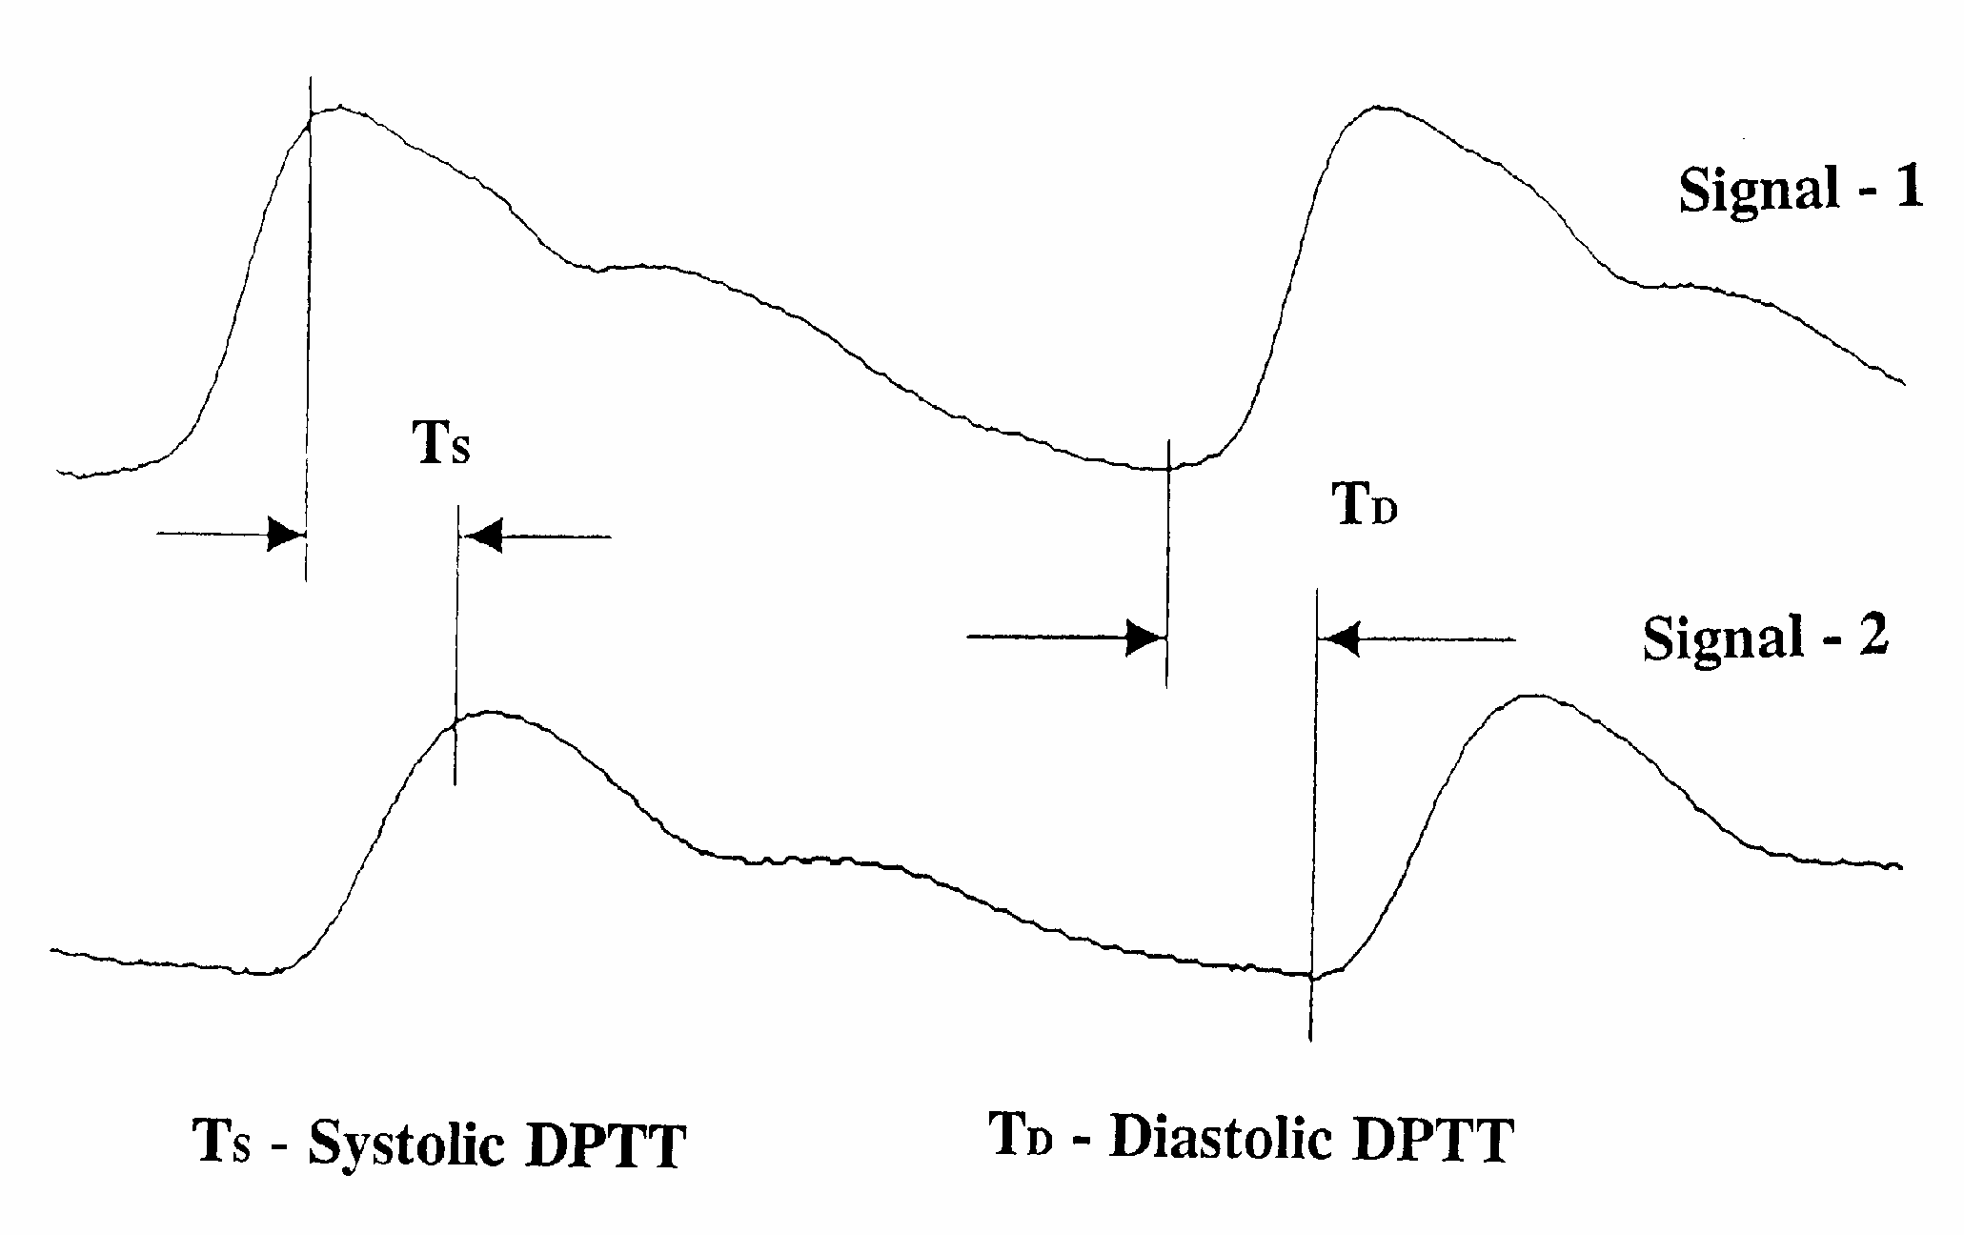
Phoenix Sensor
Presently using two piezoelectric sensors to detect pulse.
Pressure is calculated indirectly using pulse transition time.
  P = a + b ln(T)
  System must be calibrated to each patient.

Slide 3
Phoenix Sensor
Other potential implementations:
  Ultrasound
    Detect pulse with ultrasound
    Measure arterial diameter change with ultrasound
  Optical
    Detect pulse using near infrared
  Active sensor
    Introduce a mechanical pulse and measure propagation (elasticity)

Slide 4
Phoenix sensor backup slides

Slide 5
Project Description
The purpose of the piezo film pulse sensor project is to identify and build a reliable, low power, low cost blood flow sensor. The sensor is intended for two proposed designs for the ambulatory blood pressure monitor (ABPM). They are: (a) an oscillometric cuff design (as a Korotkoff sound sensor) and (b) the blood flow velocity design. The project includes the following deliverables:
Selection of the piezo film sensing element(s).
Design of a sensing circuit, including filtering and amplification stages.
Layout and fabrication of a small, low noise circuit board.
Bill of material
Evaluation of the completed sensor system.
Public invention disclosure and release.
A written report.

Slide 6
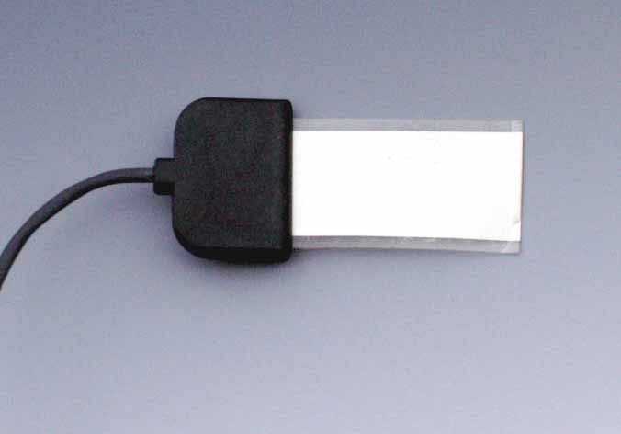
Piezo Film Sensor Element
The piezo film sensor element selected for this test was the SDT1-028K made by Measurement Specialties, Inc. It was selected because (a) it is very sensitive to low level mechanical movements, (b) it has an electrostatic shield located on both sides of the element (to minimize 50/60 Hz AC line interference), (c) it is responsive to low frequency movements in the 0.7 - 12 Hz range of interest, (d) the foil size was about right (1 inch / 2.54 cm long) and (e) it has an integral connector and cable for simple connections. An RG-174 BNC connector was attached to the opposite end of the cable (not shown).

Slide 7
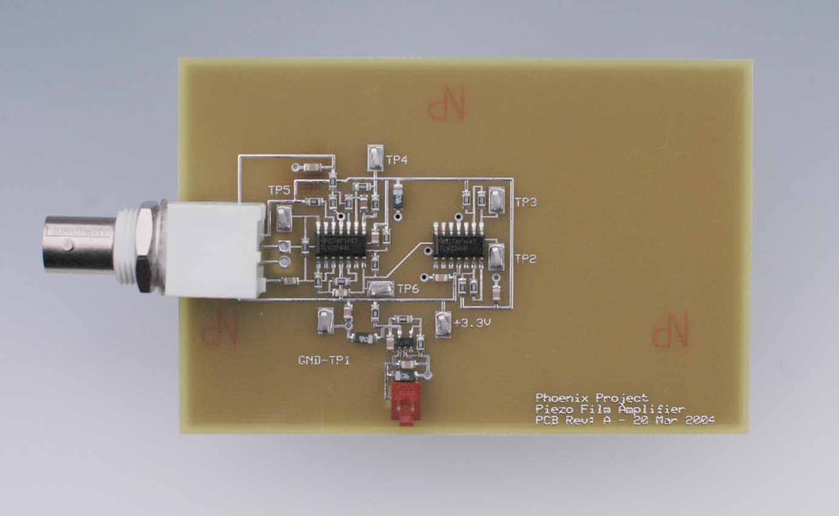
Filter/Amplifier Circuit
The filter/amplifier circuit shown was created for the piezo film sensor. It was specifically designed for battery powered operation from three AA or AAA cells (3.6 - 4.5 VDC), and consumes just 100 uA of current. The BNC connector located on the left side of the board connects to the piezo film sensor. The output is monitored with oscilloscope probe(s) via test points located on the board. The board dimensions are 2.5 inch (6.4 cm) x 3.8 inch (9.7 cm).

Slide 8
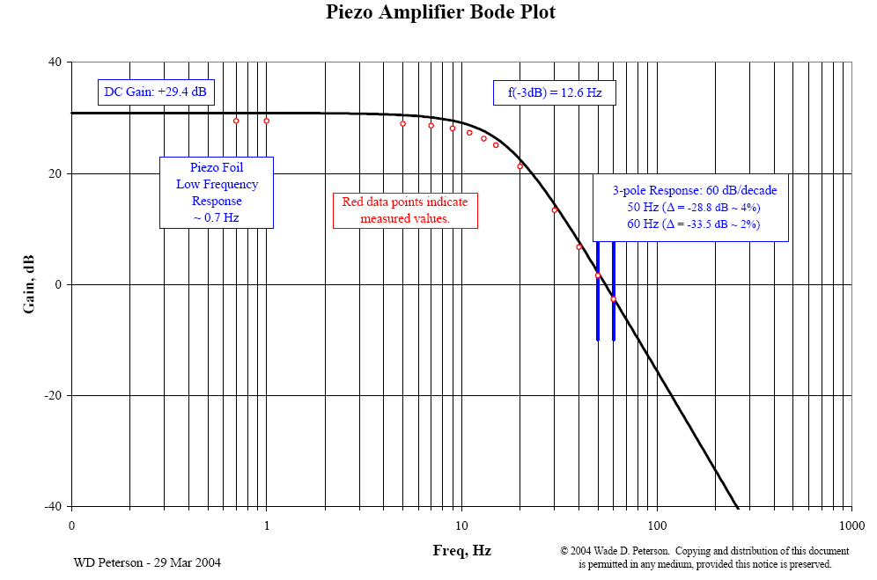
Filter/Amplifier Circuit
The circuit has a three-pole low pass filter with a lower (-3 dB) cutoff frequency at about 12-13 Hz. The main purpose of the low-pass filter is to prevent unwanted 50/60 Hz AC line interference from entering the sensor. However, the piezo film element has a wide band frequency response so the filter also attenuates any extraneous sound waves or vibrations that get into the piezo element. The DC gain is about +30 dB.
The circuit has a very high input impedance. Applications notes from Measurement Specialties, Inc. report that the low-end frequency response of the piezo film can be lowered from 5-6 Hz to 0.7 Hz by using a 10 Megohm or higher input impedance. The front end of the filter/amplifier circuit uses an op-amp follower in parallel with a 10 Megohm parallel resistor.

Slide 9
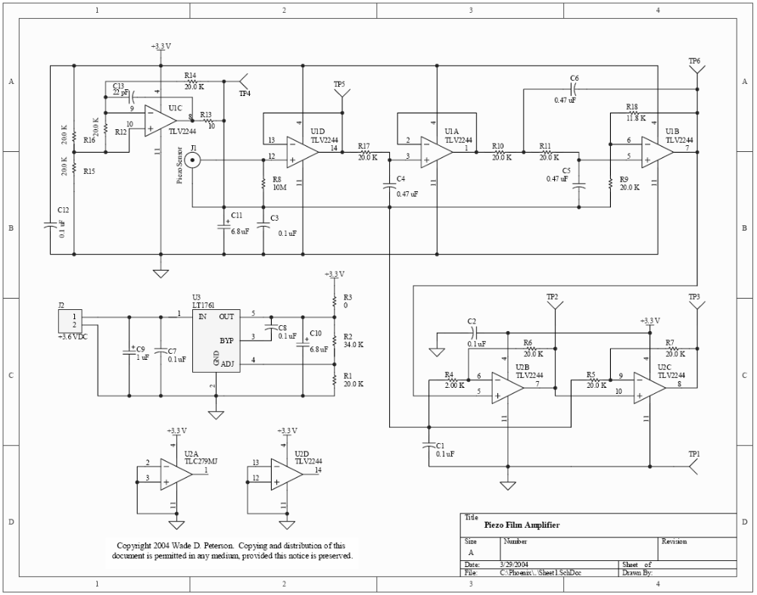
Filter/Amplifier Circuit
The PCB artwork can be modified and ordered on-line from ExpressPCB at www.expresspcb.com. Just download their free CAD software and the board artwork file named PiezoAmp.pcb. The board conforms to the specifications for their low cost 'miniboard' service. The board assembly uses surface mounted components and can be hand assembled with the aide of a small soldering iron and a microscope.

Slide 10
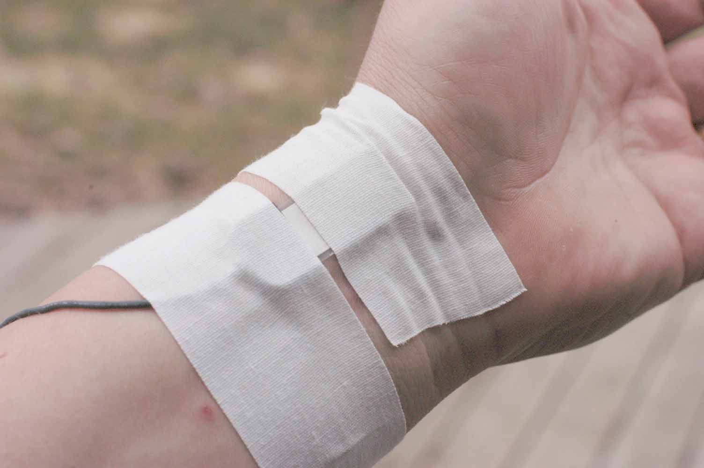
Wrist Pulse Response
The piezo film was attached to the wrist with cloth athletic tape. The sensor was placed over the pulse point. The adhesive on this tape is designed to be attached to the skin, and is breathable. It's a fairly weak adhesive which also allows the tape to be removed without damage to the piezo element.

Slide 11
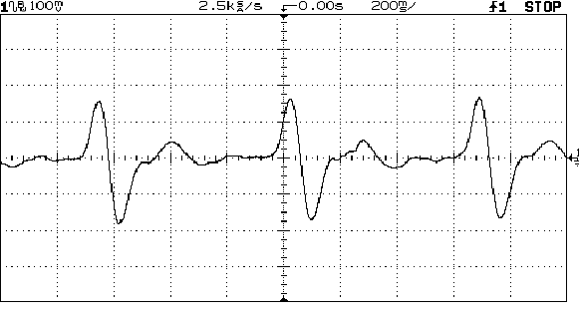
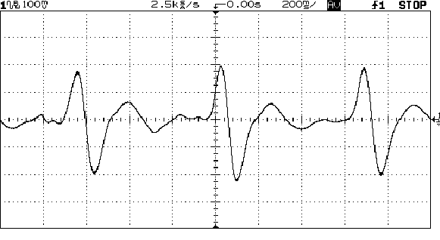
Wrist Pulse Response
Wrist pulse single sweep waveform.
The wrist pulse waveform averaged over 64 samples.

Slide 12
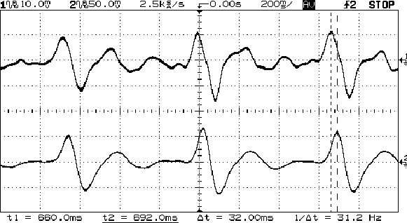
Blood Velocity Response Between Elbow and Wrist
Two identical piezo film sensors and filter/amplifier circuits were configured as a non-invasive velocity type blood pressure monitor. The first sensor was located on the inner left elbow at the same location where Korotkoff sounds are monitored during traditional blood pressure measurements with a spygmometer. The second sensor was located on the left wrist as described above (about 12 inch / 30cm from each other).

Slide 13
Correlation Between Pulse Delay & Blood Pressure
The correlation between pulse delay and blood pressure is well known in the art of non-invasive blood pressure monitors. One of the best patent references is Chen et. al, US Patent No. 6,599,251. Besides being an excellent summary of prior art in the field of non-invasive blood pressure measurement, Chen describes how blood pressure measurements are obtained using the pulse delay technique, as well as his data correlating pulse delay and pressure. However, Chen uses optoelectric sensors rather than the piezo film elements that are shown in this page. It is believed by the author that good, non-invasive blood pressure sensors using the techniques described on this page can be designed around Chen's claims.

Slide 14
Improvement Ideas
Ideas from Curt McNamara’s Innovation Study Group (IEEE) with facilitation by Mark Reeves (TRIZ expert).
Ideas are based on a piezoelectric sensor, and consider the design trade-off that closer sensor spacing reduces the signal fidelity while improving implementation cost and increasing ease of use of the final product.
Measure other aspects of the pulse, such as the transit time of the maximum pulse slope rather than the pulse peak.
Maintain a large distance between the sensors, but communicate between sensors wirelessly.
Narrow the piezoelectric element to sharpen the sensed pressure peak.
Look at information within a single piezoelectric element measurement which may indicate pressure.
Use an acoustic method to measure pulse transition time PTT (PTT is a surrogate for pressure).
Measure more than one artery at a time to improve signal resolution.
Apply a physical pulse to alter pressure signal characteristics (such as turbulence).

Slide 15
Improvement Ideas
Ideas from Curt McNamara’s Innovation Study Group (IEEE) with facilitation by Mark Reeves (TRIZ expert).
Ideas based on a piezoelectric sensor. Idea generation used S-Field analysis.
A matrix of sensors to compensate for changes in position of the sensor and to reduce noise.
  This can be further refined by fabricating a single part with an embedded sensor matrix.
Mechanical amplification of the signal. This could be based on the lever arm principle. For example: with a small suction cup dart stuck to the surface of the skin, the end of the shaft farthest from the skin will move a large distance for a small movement at the skin surface.
A piezo made up of two signal detectors in opposition with a common center. Differential measurements could be made to reduce common mode noise.
  This can be further enhanced by arranging several of the differential detectors radially.
Fabricate the piezo as an active amplifier element, such that a bias voltage across the piezo would be modulated by mechanical forces applied to the piezo. An electrical engineering analogy would be a bipolar transistor, where small changes in the base current produce large changes in the collector current.
Oscillate the piezo to optimize its operating point.

Slide 16
Improvement Ideas
Ideas from Curt McNamara’s Innovation Study Group (IEEE) with facilitation by Mark Reeves (TRIZ expert).
Ideas based on a piezoelectric sensor. Idea generation used S-Field analysis.
Convert to an active system by generating an oscillating signal with one piezo and then detecting the signal with a distal piezo.
  Hypothetically, the same change in pulse propagation time used in the passive system should apply to the active system (i.e. the generated signal should propagate faster when the blood pressure is higher).
  An advantage of an active system such as this is that a generated signal can be differentiated more easily from background noise (such as skeletal muscle contraction).
Add resonance to the active system. With a mechanically resonating detector, the pressure pulse impinging on the detector can be measured as a change in the resonance frequency, rather than as an amplitude change.
Monitor temperature, or other extraneous interference, to compensate for its effect on the pressure measurement.
Locating the sensor(s) on the arm rather than the wrist has definite advantages because there would be less change in position relative to the heart. To encourage patient compliance with this position, an MP3 player or radio could be added to the sensor. This would have the added benefit of reducing any negative social stigma associated with wearing a medical monitoring device.
Cross correlation is presently being used to measure time separation of the pressure pulses. Although this is a computationally intense method, it has the advantage (along with other methods that evaluate more of the pulse waveform morphology) of distinguishing more closely spaced pulses, allowing closer physical spacing of the sensors. Closer spacing of the sensors is not only beneficial from an ease of use and cost perspective, it improves the ability to distinguish between the pressure signal and common mode noise. (Common mode noise will distort the signal morphology in a more similar manner for closely spaced sensors, allowing it to be removed more easily.)

